Slide 1
Writing in Plain Language
Why it Matters and How to Do It
Tina Miller
Senior Associate Registrar

Slide 2
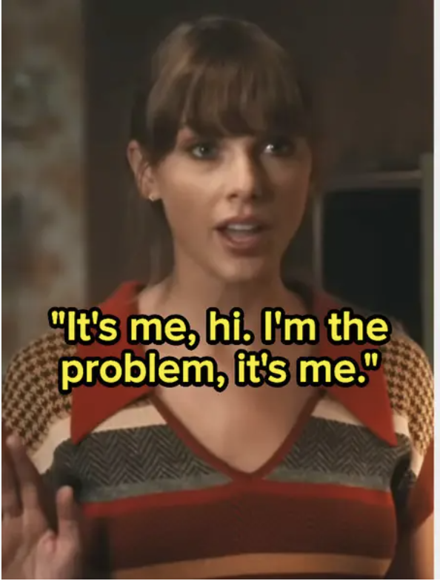
Why am I doing this?
The English Language Proficiency Requirement letter moment.
Went back to school. (Ugh.)
Learned some theories.
Did some research.
Discovered a passion.

Slide 3
What is Plain Language Writing?

Slide 4
A somewhat “unplain” definition…
“Plain English is clear, straightforward expression, using only as many words as are necessary. It is language that avoids obscurity, inflated vocabulary and convoluted sentence construction. It is not baby talk, nor is it a simplified version of the English language. Writers of plain English let their audience concentrate on the message instead of being distracted by complicated language. They make sure that their audience understands the message easily.”
https://www.plainlanguage.gov/about/definitions/short-definition/

Slide 5
A plainer definition
“Communication with clear wording, structure, and design for the intended audience to easily:
    - find what they need
    - understand what they find
    - use that information”
https://centerforplainlanguage.org/

Slide 6
Or in other words…
You go from this:
To this:
“A student absent from any examination or class activity through sickness or other cause judged by the instructor to be unavoidable shall be given an opportunity to take a rescheduled examination or perform work judged by the instructor to be the equivalent. If the instructor determines that neither alternative is feasible during the current quarter, the instructor may exempt the student from the requirement.”
(Sample from UW Scholastic Regulations)
“If you have to miss class or an exam, your teacher can decide to let you take a make up exam or do another activity. They can also decide that you are just not required to do that exam or activity.”

Slide 7
Why to write in Plain Language

Slide 8
Why to use Plain Language in our Offices
Effectiveness
Access and Equity

Slide 9
Effectiveness
We write for a reason.
Complicated language can cause readers to not understand what they need to do. That defeats the purpose of the writing.
With Plain Language, readers understand what you are trying to tell them, and more quickly.
If they actually read and understand the thing you wrote, they are more likely to do what you want them to do when you want them to do it. Which is usually why you wrote the thing in the first place.

Slide 10
Access and Equity – some background
Linguistic Capital – you speak the “right” language so you get resources needed to increase economic capital and social capital.
Cultural Reproduction – institutions can reproduce existing power structures by giving privilege to those sharing the cultural background of the class in power, which disadvantages those who are not members of that class.
Belonging – studies show feelings of belonging improve student retention. O'Keefe, P. (2013). A Sense of Belonging: Improving Student Retention. College Student Journal, 47(4), 605-613.
Friction Theory – “friction” in a student’s journey can cause progress to halt. Not all students have the same tools for dealing with these frictions and some will get derailed. Aagard, T. & Dodd, S. (2019). Graduating in Spite of Us? Identifying and Reducing Friction Points for Students. College and University, 94(3), 63-68.

Slide 11
Access and Equity – problems with “traditional academic” writing
Higher education jargon.
Who is more likely to know these terms – first generation students, or students whose parents went to college? Will a student who doesn’t understand these terms feel like they belong?
Academia-ese often uses convoluted sentence structures, including parenthetical clauses, bureaucratic tone, and complex words.
Who does this advantage, and who does it disadvantage?
Notes:
Matriculated…. prerequisite/corequisite…scholarship….probation….standing, eligibility, enroll/enrollment, Bursar, MWF/TR

Slide 12
Access and Equity – Example 1
2017 Study of international graduate admissions websites and materials.
The average materials are written at “15th grade or above” reading level, but the minimum TOEFL score expected of applicants was listed as equivalent to a “12th grade” reading level.
?
Taylor, Z. W. (2017). Speaking in tongues: Can international graduate students read international graduate admissions materials? International Journal of Higher Education, 6(3).

Slide 13
Access and Equity – Example 2
2013 study on accessibility of Community College websites
70% of the test students (which included both students with disabilities and students without disabilities as a control group) encountered difficulty completing tasks like finding class meeting times, or filling out an online form due to not being familiar with higher-ed terminology.
Erickson, W., Trerise, S., & Lee, C. (2013). The Accessibility an Usability of College Websites: Is Your Website Presenting Barriers to Potential Students? Community College Journal of Research and Practice, 37(11), 864-876.

Slide 14
Plain Language is effective, and doesn’t reinforce access and equity issues.
Plain language writing is accessible to everyone.
  Helps break cycles of cultural reproduction
  Doesn’t “gatekeep”
Plain language writing improves understanding.
  Plain language writing means readers are more likely to understand what you want them to know or do.
  Understanding helps with feelings of belonging
  Understanding leads to less “friction” that traditionally marginalized students may have a harder time overcoming.

Slide 15
So…why aren’t we already doing it?
Barriers to Plain Language writing in higher education

Slide 16

Barrier 1: Time
We are busy… | But:
We have learned to not write in Plain Language, and re-training ourselves takes time we may not feel we have. Plus, who wants to take more time composing an email!?
Professional development is worth spending time on (we’re here, aren’t we?). And if most readers understand your email, you will get fewer questions…which means fewer emails!
The thought of rewriting everything is overwhelming!
So…don’t? At least not right away.
Are there “trouble spots?”
Are you updating something anyway?
Can you start something new using Plain Language?

Slide 17

Barrier 2: Internal Thoughts
We may think… | But:
I’m not a bad writer!
It’s not that you’re a “bad writer” now, you’re just not using the best kind of writing for the task.
If I write in a basic way people will think I’m not smart.
Plain Language writing isn’t “dumbed down” writing -- it’s a skill. Advertise your skill by becoming an advocate.
I don’t want to leave anything out that someone might want to know!
Realistically, most readers aren’t going to care about the background policy, history, or the one strange possible outlier you can think of. And you can still include it if you want, just in the right place!

Slide 18

Barrier 3: Institutional Biases
They might say… | But:
Our tradition is to write like this. This is how we do things.
“Tradition” includes an unfortunate history of exclusion. Times change.
“A college student should be able to understand….” or “We shouldn’t be dumbing down our writing.”
According to whom? Question the biases.
Plain Language writing for students is analogous to disciplinary writing.
What about our reputation?
The student (and prospective student) population has changed. Institutions need to adapt to survive.
Notes:
Go back to the US Govt definition of plain language writing I showed earlier: “Plain language is not baby talk, nor is it a simplified version of the English language.” It is a specific style of writing, done for a specific purpose.

Slide 19
So…let’s learn some Plain Language writing basics

Slide 20
1 - Understand who you are writing to/for and why.
What do you want them to do? If it’s not clear to you, it won’t be for them!
What do they need to know to do it? And what don’t they need to know? (Hint, you’ll want to leave one of these out.)
Consider what words or concepts would someone at the lowest level of pre-existing understanding likely know already or not?
Don’t try to do too much. Fewer “things” per message are better.
Notes:
Piggybacking is tempting – may seem to be more efficient. But it dilutes message.

Slide 21
2 – Structure your message/page to guide your reader.
Write like an old-school journalist. Put the Who, What, When, How, Why up front/at top. Less important details, background policy, etc., can go lower (so if they stop reading, they still get the important things!)
Make it easy to read visually. Use short paragraphs, bullet points, headings, and white space to avoid a “wall of text.”
Use font size, color, bold, etc., to help guide the reader’s attention (but don’t overdo it and cause visual clutter!).
Use images to make content easier to understand.
Notes:
School of Medicine for MD – all emails from office start with a little chart: who it’s for (e.g., 2nd year students) what, when.

Slide 22
3 – Mind your language
Avoid complicated words when there are simpler ones you can use (hint – use a cheat sheet like the one I’ll provide).
Use strong, active verbs.
Be direct – avoid passive voice.
Keep sentences short – about 15 to 20 words.
Avoid jargon and technical terms. If you can’t, provide a definition the first time. Or even create a “vocabulary” list of terms to know (see Everett Community College’s “College Vocabulary” on page 175 of their 2020-21 Catalog!).
Notes:
Courses are registered for by students vs Students register for courses.

Slide 23
4 – Use tools
“Readability checkers” (Microsoft Word has a Flesch-Kincaid readability tool built in, for example.) Go here to learn how to set it up.
Use a Plain Writing Planning Worksheet (here’s a sample one I made – feel free to modify for your own use!)
Have someone who is like your intended reader review what you wrote and give you feedback.
Use AI. For example, Goblin Tools has a “Formalizer” that lets you paste writing in and make it easier to read, less formal, or more to the point. I recommend the “unwaffle.” Use AI with caution.
Notes:
Lots of online readability checker tools. Apples to apples though.
AI – not a little brain out there. Compiler/predicter. Double check that meaning wasn’t lost. More of a starting point.

Slide 24
Websites you may like, plus my email
https://www.plainlanguage.gov/
https://centerforplainlanguage.org/
https://www.nala.ie/plain-english/plain-english-tips/
https://eab.com/insights/blogs/community-college/the-art-of-effective-student-communication/
https://goblin.tools/Formalizer
millert@uw.edu – email me!!

