Slide 1
WaACRAO 2020
FERPA Tales From the Road: Colleagues from All Sectors Share Their Stories and Wisdom
August 6, 2020

Slide 2
Agenda
Panel Intros and Session Logistics
Your Questions - Post in Chat
FERPA Basics
Most Common Training Questions
Challenging FERPA Scenarios
Data Breach Prevention
Accidental Breaches and Remediation
Hot FERPA Topics
JW

Slide 3
Panelists
Emilee Langbehn Bosh, Records Manager & Commencement Coordinator, Whitworth University, elangbehn@whitworth.edu
Helen B. Garrett, Ed.D., University Registrar and Chief Officer of Enrollment Information Services, University of Washington, helenbg@uw.edu
Biljana Jovanovska, Campus Registrar, WSU Vancouver
biljana.jovanovska@wsu.edu
David Stolier, Sr. Assistant Attorney General, Education Division
Jenny Wheeler, Registrar, Green River College jwheeler@greenriver.edu
JW

Slide 4
Zoom Webinar Tips
Raise your hand feature
Use the Q&A feature to post your questions
JW

Slide 5
Your Questions?
Why did the chicken cross the road?
Sorry, I can’t tell you without a release!
Please post your questions in the Q&A
After WaCRAO, we will send out this slide deck and the Q&A transcript answering all questions asked
JW

Slide 6
FERPA BASICS
HBG

Slide 7
How well do you know FERPA?
1 Finger
FERPA, huh? I thought this was the WaACRAO prize raffle Zoom session
5 Fingers
I could hold my own if a man with a badge appeared!
10 Fingers
I know this and am just here for moral support for my WaACRAO friends!
HBG

Slide 8
In FERPA Speak
1
Access to education records, with 99.31 exceptions
2
Control over access, with exceptions
3
Right to challenge contents
HBG

Slide 9
In Plain English
1
Right to inspect and review educational records
2
Right to control disclosure of information from educational records
3
Right to seek amendment to incorrect educational records
HBG

Slide 10
What is FERPA?
Family Educational Rights and Privacy Act of 1974
Helen in 1974
U. S. Department of Education https://www2.ed.gov/policy/gen/guid/fpco/ferpa/index.html
HBG

Slide 11
Who is Responsible for FERPA?
Typically the Registrar
Who else should care? Everyone!
Financial Aid
Business Office
Legal Counsel
Counseling and Advising
President’s Office
Athletics
Faculty
Departments
Etc.
Anyone with access to student records, including student employees
HBG

Slide 12
Who has FERPA Rights?
All students attending an institution of higher education receiving federal Title IV funds, regardless of age
All students for whom records are maintained, regardless of method
Parents lose rights when student is in attendance, regardless of age
Students retain all FERPA rights until deceased
HBG

Slide 13
FERPA Annual Notification Requirements
Right and method to inspect and review
Right and method to seek amendment
Right to consent
Other than 99.31 exceptions
Right to file a complaint with the Department of Education
Definition of legitimate educational interest/school officials
Directory information
Defined by institution
HBG

Slide 14
Eight Data Points You May Not Release!* (Even to parents paying the bills)
Social Security Number
Citizenship
Gender
Ethnicity
Religious preference
Grades
GPA
Daily class schedule
*Except to the student and school officials
HBG

Slide 15
KEY DEFINITIONS
HBG

Slide 16
Important FERPA Terms
Student
Anyone attending your institution, of any age
Student Record
Any information or data recorded in any medium
Educational Record
Any information directly related to a student, maintained by an educational agency or institution
HBG

Slide 17
Important FERPA Terms (cont’d)
Directory Information
Student info that would not be harmful if disclosed
School Official
Member of an institution acting in a student’s educational interest, limits on “need to know”
Personally Identifiable Information (PII)
Identifiable information that is maintained in education records and includes direct identifiers, such as student’s name or identification number, indirect identifiers, such as a student’s date of birth, or other information which can be used to distinguish or trace an individual’s identity either directly or indirectly through linkages with other information.
HBG

Slide 18
What Exactly is a Student?
In attendance
Institutionally defined
All students for whom records are maintained, regardless of method
Rights begin when in attendance regardless of age
Parents lose right at 18 or when attending
Acquire all FERPA rights when a student
HBG

Slide 19
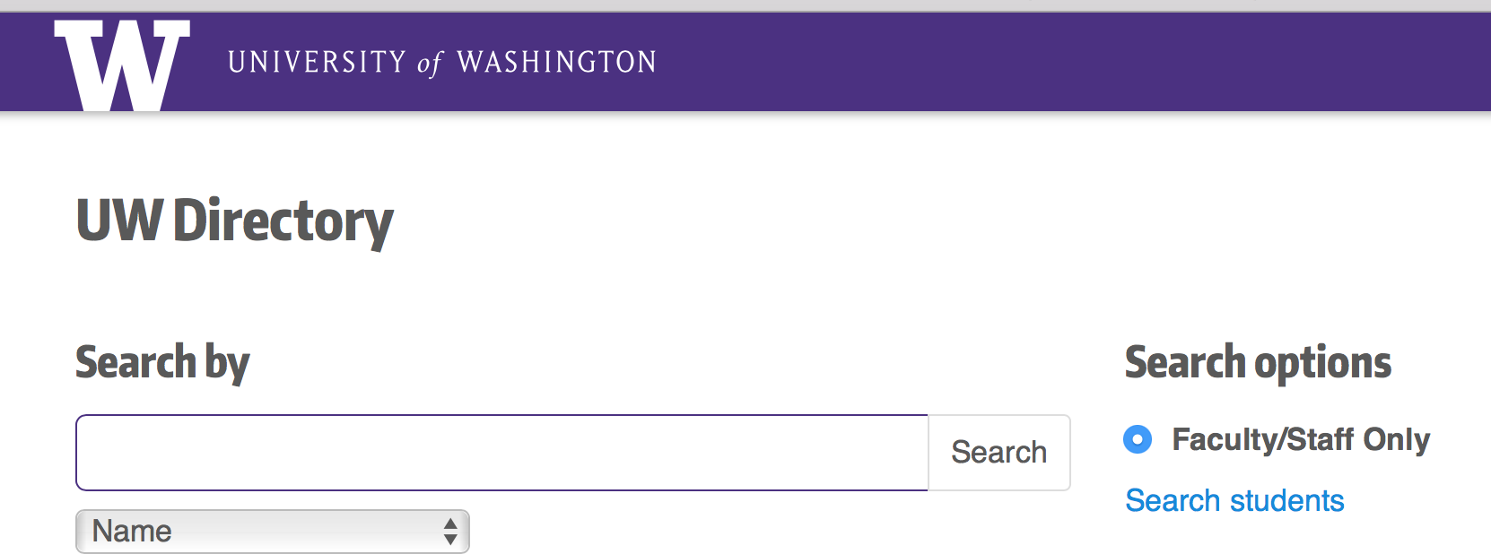
FERPA Allowed Directory Information
Institution decides, but may include:
Student’s name
Telephone number
Photograph
Dates of attendance
Major, field of study
Grade level
Weight/height of athletes
Participation in sports
Recognized activities
Most recent educational agency
Other institutions attended
Address
Email address
Enrollment status
Date and place of birth
Degrees, honors, & awards
HBG

Slide 20
What is UW’s Directory Information?
https://registrar.washington.edu/students/ferpa/
Pursuant to WAC 478-140-024(5), directory information at the University of Washington is defined as:
Student’s Name | Street Address
Email Address | Telephone Number
Date of Birth | Date of Attendance (Not Daily)
Degrees & Awards Received | Major/Minor(s) Field of Study
Class (i.e. FR/SO) | Participation in Officially Recognized Activities/Sports
Weight/height-Intercollegiate Athletes | Student’s Name Most Recent Previous Educational Agency or Institution Attended by Student

Slide 21
What is Allowed – Not UW Directory Information?
Institution decides, but may include:
Student’s name
Telephone number
Photograph
Dates of attendance
Major, field of study
Grade level
Weight/height of athletes
Participation in sports
Recognized activities
Most recent educational agency
Other institutions attended
Address
Email address
Enrollment status
Date and place of birth
Degrees, honors, & awards
HBG

Slide 22
What is an “Opt-Out”?
Code in your system to acknowledge students’ decision to opt-out of directory information release (SDB/EARS)
Must be visible to anyone who might release information
Most misunderstood aspect of FERPA
All student records are confidential
Directory information is ok to release, unless opt-out is in place
Never have to release directory information to anyone, except to student
If you do not know how to see the Opt-Out ”FERPA No” you may not release any Directory Information
HBG

Slide 23
What are not Educational Records?
Law enforcement records*
Treatment/medical records*
Alumni records
Employment records (unless job is for a student only)
Sole possession records
*once disclosed become educational records
HBG

Slide 24
Who are School Officials?
Individual or group providing a necessary service
No inherent rights under FERPA
Have a “need to know” status
i.e. legitimate educational interest
Responsible for knowing FERPA
Outsourced parties performing duties done by school officials
Listed in annual FERPA notification
Records remain under control of the institution
Must not re-disclose information
HBG

Slide 25
99.31 Exceptions?
To the student
School officials
Post-secondary institutions
Student seeks to enroll or is enrolled
Authorized federal, state or local educational agencies
In connection with financial aid to determine award
Organizations conducting studies for the institution
Parents of dependent students
In compliance with a judicial order or subpoena
In connection with a health or safety emergency
Directory information: no opt-out
HBG

Slide 26
Who has FERPA Rights?
All students attending an institution of higher education receiving federal Title IV funds, regardless of age
All students for whom records are maintained, regardless of method
Parents lose rights when student is in attendance, regardless of age
Students retain all FERPA rights until deceased
HBG

Slide 27
Most Common Training Questions
HBG

Slide 28
Emilee
When and what can I share with parents?
If someone who works at the university requests information, can I share it for any reason?
Why can’t I just add anyone I want to my Blackboard roster regardless of whether or not they are registered for the course?

Slide 29
Jenny
What should I say to a parent or spouse who is asking for student information?
When do I need a signed release and what do I do with it?
What steps do I need to take to verify a student’s identity? (phone, in-person, zoom)

Slide 30
Biljana
How can I share graded assignments with students when a course is not set up in blackboard?
Parent wants to know if the student is registered for the current semester. Should you release this information?
Working from home: How to prepare for FERPA in the virtual world? What are the most valuable lessons learned?

Slide 31
Challenging Scenarios
JW

Slide 32
Emilee
Parent calls because a family member has passed away or there is a “family emergency” and wants student information.
Verifying identity of constituent, especially pre-1991 alumni.

Slide 33
Jenny
Student information being released to other students
How to email student data to other school officials (email encryption)
Method of signed releases being submitted (from parents, non-college emails, etc.)
Friend/family wants to pick up transcript, diploma, etc. for a student

Slide 34
Biljana
National VA audit during COVID-19
Seven areas as part of the compliance survey
Three weeks deadline
No secure platform set for transfer of data
Prior institutional security breach
Security team involved
Encrypted transfer of data via USB
Encrypted emails

Slide 35
Data Breach Prevention
JW

Slide 36
Parties Outside the Institution Want Your Student Data
Government agencies, legislators, researchers, contractors, businesses
Even with the best of motives, any disclosure must be grounded in one of the exceptions listed on Slide 25
Can the data be aggregated or de-identified?
Written agreement: purposes, no re-disclosure, destroy when finished
DS

Slide 37
Data Breach Consequences
FERPA Complaint to USDOE – See Bonus Slides
Credibility deficit with your students
Bad press
Monetary costs of remediation and mitigation
Potential lawsuits
Procure cyber-liability insurance
DS

Slide 38
Data Breach - Notification Laws
RCW 42.56.590, applicable to all state institutions
RCW 19.255.010, applicable to private institutions
Upon discovery of data breach involving PI, must immediately disclose to PI owner, if the PI was, or is reasonably believed to have been acquired by an unauthorized person
Minimum notice elements: contact for institution, list of types of PI disclosed; time frame of exposure & date of discovery of breach; contacts of credit reporting agencies
Notify Attorney General if more than 500 WA residents implicated in a single breach
PI includes first and last name in combination with a list of other data elements, including DOB, SSN, SSID.
Office of Chief Information Officer (OCIO) Policy 143, “IT Security Incident Communication.” Report all IT security incidents to OCIO. https://ocio.wa.gov/policy/it-security-incident-communication
IT Security Incident: “Any unplanned or suspected event that could pose a threat to the integrity, availability or confidentiality of an Agency's, or the State’s, data or systems.”
DS

Slide 39
Accidental Breaches and Remediation
JW

Slide 40
Emilee
Student Accounts tells a parent without a FERPA release on file that the student’s billing has changed because they dropped Chemistry 161 on September 10th.
Mom, without a FERPA release, emails all instructors explaining that daughter is in in-patient therapy and needs them all to communicate directly with her moving forward. Instructors do so rather than going through proper channels and send Mom protected information about the student.

Slide 41
Jenny
Spreadsheet of students’ information on multiple class rosters sent to all those students
Incorrectly using mail-merge (sending another student’s FA/Workstudy info)
Sending a spreadsheet of multiple student’s information to a personal email address so they can work on it from home

Slide 42
Biljana
Have you ever replied-all?
CC: or BCC:
Auto filled email addresses
Dropbox without security settings, access, and roles

Slide 43
Hot FERPA Topics
MM

Slide 44
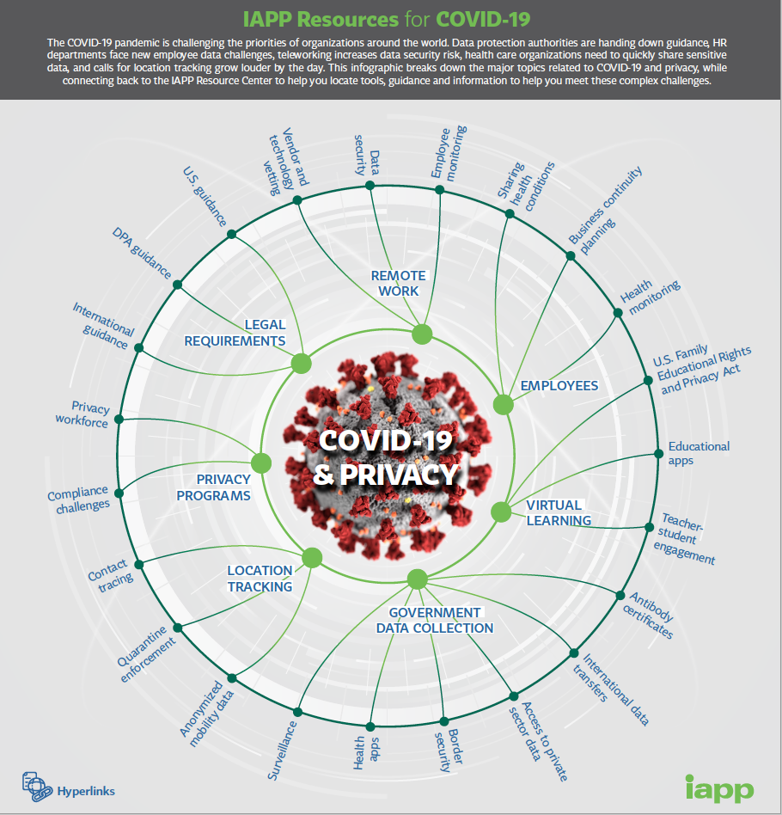
What COVID-19 Has Done to FERPA and Privacy...
HBG

Slide 45
FERPA Guidelines-Classroom Zoom and Other Recordings
Order from AACRAO
https://community.aacrao.org/CPBase__item?id=a1H1V000008cfErUAI
Hot Topics:
Remote work and FERPA
Recent International and state
privacy law updates
Recording students
US Dept of Education FERPA &
Coronavirus Disease (2019)
UW Privacy Resources Best
Practices for Live Streaming
HBG

Slide 46
FERPA AND SCHOOL SAFETY
“FERPA is an area where widespread confusion remains, and this clarification will give local school leaders and law enforcement the tools they need to protect student privacy while ensuring the health and safety of students and others in the school community." U.S. Secretary of Education Betsy DeVos
School Resource Officers, School Law Enforcement Units, and the Family Educational Rights and Privacy Act (FERPA) - February 2019
https://studentprivacy.ed.gov/resources/school-resource-officers-school-law-enforcement-units-and-ferpa
HBG

Slide 47
Considering Releasing Student Data?
Ask yourself the “W” questions:
Why am I being asked to release student data?
Who is asking?
What student release is needed?
What determines that this is a student record?
What is the record being requested?
Where is this student record going?
Where do I need to record that it was released?
HBG

Slide 48
When in Doubt, Don’t Give It Out
You are never obligated to give out FERPA protected information.
FERPA law states that schools have up to 45 days to provide students with access to their information and this does not require the information to be copied and released, but just to make the information visible to review.
The more pressure you are receiving to release information, the more you want to assume that the person asking does not have the right to access the student’s information.
HBG

Slide 49
When in Doubt, Don’t Give It Out
Before releasing data, consider:
Educational Record?
Student?
Signature required?
Must vs. may: do I have to release?
School official: do they provide a service to institution?
Need to know: job-related?
Is this directory information? Opt-out in place?
Institutional policies and procedures?
HBG

Slide 50
Bonus FERPA Training Content-HBG
HBG

Slide 51
Emails and FERPA Compliance
An institutional .edu email can be emulated
Use methods that require authentication using a unique institutional ID to share student data via email; especially when it involves more than one student record
Refrain from sharing specific student data (GPA, grades, disciplinary information) by email alone
Use .edu emails when sending emails. Do not use personal email addresses for students or to send and receive emails
Consider adding this statement to your Outlook signature block:
Privileged, confidential or patient-identifiable information may be contained in this message. This information is meant only for the use of the intended recipients. If you are not the intended recipient, or if the message has been addressed to you in error, do not read, disclose, reproduce, distribute, disseminate, or otherwise use this transmission. Instead, please notify the sender by reply e-mail, and then destroy all copies of the message and any attachments. Thank you

Slide 52
Faculty Issues
Tips for Letters of Recommendation and FERPA
Be sure to obtain a release from the student to complete any recommendation form or to provide a letter of recommendation asking for student records beyond faculty observations
Observations (i.e. student contributed significantly) are not FERPA student records and can be given freely
Permission to provide a recommendation can be written and/or in an email from the student. Save it for at least six months.
Know exactly what you are allowed to comment on or not:
Grades/attendance/GPA – you must have written permission from the student to release these and any other student record data points
Permission to complete an external reference form must be signed by the student, if it comes externally. Often this is on the form itself.
Requests from federal entities must have student permission to release any student record information as part of a recommendation

Slide 53
Law Enforcement Inquiries
Do not allow anyone access to students in your classrooms including other students looking for them (regardless of the reason), or:
FBI
CIA
Police
Anyone with a badge
Refer these individuals to the Office of the University Registrar or UW Police Department

Slide 54
HIPAA/Medical Records
FERPA does apply to Health Clinic/Disability Services/Counseling Services records.
FERPA applies to most public and private postsecondary institutions and thus, to the records of the students these campuses service.
These records will be either education records or treatment records under FERPA, both of which are excluded under the HIPAA privacy rule, even if the school is a HIPAA covered entity.

Slide 55
Health and Safety Emergencies
If you sense that a student may be in danger to himself or herself or to any other person:
Emergency? Call 911.
FERPA exists to protect the privacy of student records, but if a threat of danger or violence is present, and you need to report FERPA protected information to non-UW officials, you may do so.
Notify Office of the Registrar afterward of the nature of the release and what was released to whom.
Example UW Protocol When Releasing Disclosing PI Related to Health and Safety Emergency:
https://registrar.washington.edu/staffandfaculty/protocol-when-disclosing-personally-identifiable-student-information-related-to-a-health-or-safety-emergency-situation/

Slide 56
Health and Safety Emergencies
“Articulable and significant threat to the health and safety of the student or other individuals”
May release to local law enforcement, parents or outside entities if release is related to safety
Must record release in student records
To whom
What was released
Why (health and safety emergency)

Slide 57
Law Enforcement Inquiries
FERPA records cannot mix with Campus Safety records
Automatically become FERPA protected if this happens
Outside entities with badges cannot have access to student data without student permission
Exception: in a health or safety emergency
Do not release a student’s schedule or location without student’s written permission
Even to law enforcement!

Slide 58
Federal Employees/Military Requests
Solomon Act
May release data to each branch of the military once each term
Student is at least 17, registered in at least one credit
Can exclude opt-out students
May charge a fee
Federal/military reps must have a signed release to obtain student FERPA protected data (i.e. transcripts/bills)

Slide 59
Faculty Issues
Peer Grading
Letters of recommendation
Releasing information to lawyers/law enforcement
Posting grades/records
Faculty may only access information related to the class they are teaching or advising
Students can no longer ask/expect to be anonymous in the classroom

Slide 60
FERPA REQUESTS VS PUBLIC RECORDS
FERPA Request | Public Records Request
Student Record of Student | Cannot be a student record
45 Days to Respond | 5 Days to Acknowledge Request
Requester Identified as Student | Requester Not to be Identified
No Requirement to track if released to student | Requirement to track request

Slide 61
Subpoenas/Judicial Orders
Duces Tecum – requires documents, papers for the court
Ad Testificandum – requires a person to testify
Must make reasonable attempt to notify student
14 calendar days or 10 working days
Exception is for Federal Grand Jury – do not notify!
Must only respond to court with jurisdiction or to a federal district court
Student may “quash” subpoena
Consult college legal counsel

Slide 62
Third Parties
May disclose personally identifiable information to:
Contractor
Consultant
Volunteer
Other party doing work normally done by institution
Data belongs to student and is in custody of institution
Must train on FERPA/no third party re-disclosures
Put in annual FERPA notice
May not re-disclose in response to subpoena or judicial order without institution notifying student

Slide 63
Registered Sex Offenders
Disclosures under the Campus Sex Crimes Prevention Act
FERPA law requires/encourages educational institutions to collect and maintain information on registered sex offenders
Notify faculty if underage student in class, registered sex offender must choose another section, do not notify under age student

Slide 64
Disciplinary Records
May release outcome of disciplinary hearing to victim of the crime
Disciplinary records are not sole possession records and are therefore subject to FERPA
May release information to institution where student seeks to enroll or has enrolled
May release if related to a health and safety emergency

Slide 65
Using SSN/Passwords
Social Security Numbers (any or all) cannot be used as directory information or to confirm identity of a student
Schools should not allow easy to know information (such as date or place of birth, mother’s maiden name) as a password prompt or a way to access student records
Take care when releasing information on the phone, use data (not SSN) known only to student
i.e. classes taken/former instructor names

Slide 66
Authorized Representatives
Requests for Information
May release with written agreements related to studies conducted for institution
Authorized reps can be any national or state authority or educational body
Can re-disclose
Ask them not to and to destroy unused data
Personally identifiable information can move back and forth between institution and agency now without student’s consent
Agencies must abide by FERPA

Slide 67
Campus Leaders
Do not assume campus leaders all know FERPA
Take care when releasing information to school officials in a position of authority
Is this a school official with a legitimate need to know?
If release violates FERPA, decline the request. If required to comply, make note of the request and to whom it was released in student’s record.

Slide 68
Parents
You may release to parents:
With students’ written permission
In connection with a health or safety emergency
If student is under 21 and violates law or school policy related to alcohol or a controlled substance
If student is a dependent for tax purposes

Slide 69
TIPS FOR NAVIGATING BREACHES
Technically - Remediation is Not Identified in the FERPA Law Itself. Words not in the FERPA Law:
Data Breach
Accidental Release
Mandatory notice
Mandatory
Myths galore in terms of what we must do

Slide 70
IMPROVING THE EFFECTIVENESS AND EFFICIENCY OF FERPA ENFORCEMENT
Department wants to provide more timely and effective assistance
Implementing a risk-based approach to processing and resolving FERPA complaints
Department is modifying its investigatory practices.
https://studentprivacy.ed.gov/FERPA-Enforcement-Notice

Slide 71
IMPROVING THE EFFECTIVENESS AND EFFICIENCY OF FERPA ENFORCEMENT
Subpart E of part 99 does not require formal investigation of all complaints, but specifies steps to take if the Department decides formal investigation is the appropriate action to address a complaint.
The best and most reasonable approach to improve processes consistent with law is to make a case-by-case determination for every timely complaint
Sometimes, the action will be a formal investigation; for these complaints, we will investigate consistent with the regulatory provisions under Subpart E of part 99.
For other complaints, consistent with the statute and applicable regulations, we will take appropriate actions such as acting as an intermediary or providing resolution assistance.
Department may address these complaints by acting as an intermediary between the educational agency or institution and the parent or eligible student, with the aim of resolving the dispute in a mutually satisfactory way.

Slide 72
TIPS FOR NAVIGATING BREACHES
If there was an unintentional violation and the institution follows all appropriate procedures to avoid these mistakes from recurring, this satisfies the intent of the FERPA law.
If the student is not satisfied with the review, they can file a formal complaint with the FPCO. The President of the university is contacted with a detailed explanation of the violation and the extent of their dissatisfaction.
All administrative parties review the situation and recommend additional methods to satisfy the student and the FPCO. Further, the university will be required to provide their formal response within a designated time period and an action plan

Slide 73
TIPS FOR NAVIGATING BREACHES
Stay calm - no one has ever lost Title IV Funding
Remediate the Release
Pull back the data if possible or notify recipients of the release and ask them to delete
Provide training for the person who accidentally released the data
Notify the students (not required, but a best practice)
Make note in the student record for those whose data was released:
Data released and generally to whom
When accidental release occurred
Training provided

Slide 74
TIPS FOR NAVIGATING BREACHES
Privacy Technical Assistance Center
https://studentprivacy.ed.gov/
Your Chief Information Security Office (if you have one)
Data Breach Response
https://studentprivacy.ed.gov/resources/data-breach-response-training-kit
Data Response Checklist
https://studentprivacy.ed.gov/resources/data-breach-response-checklist

Slide 75
TIPS FOR NAVIGATING BREACHES
Small Schools
Request PTAC Assistance
https://studentprivacy.ed.gov/request-ptac-training-or-technical-assistance
Department of Education Ask a Question Contact:
https://studentprivacy.ed.gov/contact
Large Schools
Institutional legal counsel
Chief Information Security Office
Privacy Office
Media Relations

Slide 76
UW PRIVACY OFFICE REMEDIATION
Report it to UW Privacy (Or Registrar)
Immediately isolate the systems or issues
Preserve system logs
Limit sharing of information - limit it to need to know
Be clear about what is substantiated or not, if we do not know the facts that is ok
Mark documents “draft” until finalized
Report:
Date of discovery
Date it occurred
Brief Description
Type of data involved
Number of identifiable records
Organization(s) or unit(s) involved
Students impacted
Systems involved
Send names of impacted students to Registrar

Slide 77
UW PRIVACY OFFICE REMEDIATION
Conduct your own forensic analysis
Delete, move, or alter files on the system (preserve evidence)
Blast email to all involved about the breach
Spin or propagate unsubstantiated facts
Communicate that there is a breach to individuals:
Not contributing facts
Are not decision makers
Involved in the incident management process
To those not impacted by the reach
External to your institution

