Slide 1
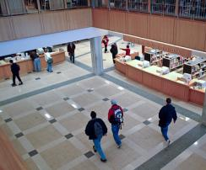
WaACRAO Legislative Update Cody Eccles Director of Government Relations & Business Affairs
CENTRAL WASHINGTON UNIVERSITY
EASTERN WASHINGTON UNIVERSITY
THE EVERGREEN STATE COLLEGE
UNIVERSITY OF WASHINGTON
WASHINGTON STATE UNIVERSITY
WESTERN WASHINGTON UNIVERSITY

Slide 2
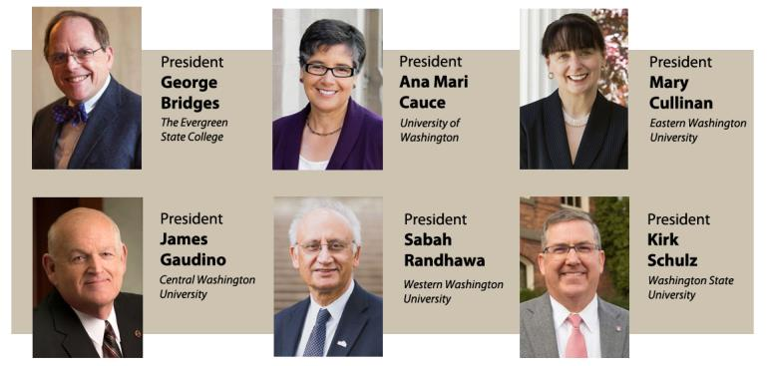
About COP
COP is an association of Washington’s six public baccalaureate degree granting college and universities. We strive to be a common voice for the public baccalaureate sector and the most respected and trusted resource for decision makers on issues affecting public higher education. We foster coordination and collaboration among the public baccalaureates as well as with myriad other partners.

Slide 3
COP Committees

Slide 4
COP Core Purposes
Leadership
Policy
Legislative
Increase the profile of the sector through social media and other communication formats.
Ensure the long-term success of our six member institutions.
Facilitate institutional and sector conversations to advance public four-year higher education.
Implement state legislation.
Collaborate with educational partners on academic, business, student affairs, and workforce policy.
Partner with the Education Reseach and Data Center on data collection and analysis.
Represent Washington's public four-year sector in the legislative process.
Engage internal stakeholders in legislative process.
General
Develop and update sector reports, briefs, and factsheets.
Organize events for collaboration within and promotion of the sector with external audiences.
Research higher education issues to inform sector conversations and strategic direction.
Communicate and collaborate with education, workforce, business, and community partners.
Represent sector on state cross-sector councils, committees, work groups, and task forces.
Advocate for public four-year higher education at the state and federal levels.
Strategic development of sector-level policies, practices and advocacy.
Proactively engage with legislators, statewide elected officials, and their staff.
Develop and respond to policy and budget proposals.

Slide 5
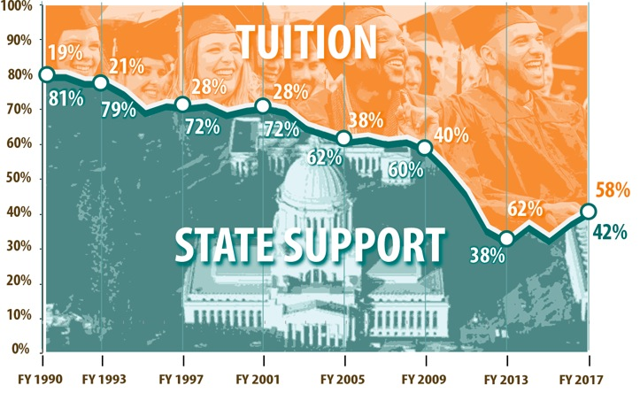
Tuition & State Funding History Over Time
Constant Dollars per FTE
Source: Legislative Evaluation and Accountability Program, June 2016

Slide 6
Tuition Policy and the State Budget
Large declines in state funding during the Great Recession resulted in the Legislature authorizing double digit tuition increases for resident undergraduates in the operating budget.
Beginning in 2013, state reinvestment in higher education led to two years of tuition freezes and two additional years of tuition reductions.
Three separate tuition policies existed during this time. Currently, resident undergraduate tuition growth is connected with the average annual percentage growth rate in the median Washington hourly wage (~2.1% per year).
 | LEGISLATIVELY AUTHORIZED TUITION CHANGE
 | 2007-08 | 2008-09 | 2009-10 | 2010-11 | 2011-12 | 2012-13 | 2013-14 | 2014-15 | 2015-16 | 2016-17 | 2017-18 | 2018-19
CWU | 5% | 5% | 14% | 14% | 14% | 14% | 0% | 0% | -5% | -15% | 2.2% | 2.2%
EWU | 5% | 5% | 14% | 14% | 11% | 11% | 0% | 0% | -5% | -15% | 2.2% | 2.2%
TESC | 5% | 5% | 14% | 14% | 14% | 14% | 0% | 0% | -5% | -15% | 2.2% | 2.2%
UW | 7% | 7% | 14% | 14% | 16%* | 16% | 0% | 0% | -5% | -10% | 2.2% | 2.2%
WSU | 7% | 7% | 14% | 14% | 16% | 16% | 0% | 0% | -5% | -10% | 2.2% | 2.2%
WWU | 5% | 5% | 14% | 14% | 16% | 16% | 0% | 0% | -5% | -15% | 2.2% | 2.2%
*UW increased tuition by 20% for the 2011-12 academic year.
Notes:
Due to state funding cuts not due to RUG tuition setting authority.

Slide 7
Tuition & State Funding History Over Time

Slide 8
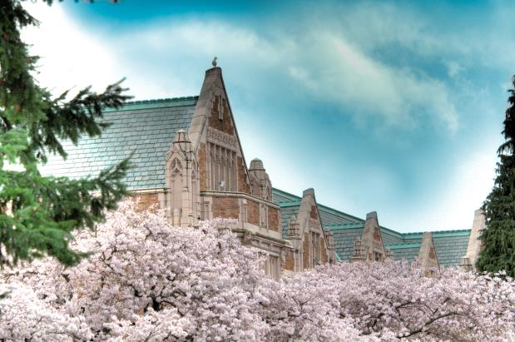
Free College, State Need Grant, & College Affordability

Slide 9
Free College, SNG, & College Affordability
2017 Free College Initiatives
HB 1840 (Pollet)/SB 5666 (Frockt) Washington promise program – Free community college)
HB 1841 (Pollet)/SB 5476 (Frockt) State need grant eligibility expansion act – Expanded eligibility to 85% of MFI
2018 Free College & SNG Initiatives
SB 6101 (Ranker) Establishing the evergreen investment scholarship program - provided an award for a free 13th year of college for low-income students, 70% of median family income (MFI), and ramp up to four years of free college for students under 100% of state MFI (currently $87,000 for a family of four
SB 6593 (Ranker) Relating to higher education
Introduced late in session
made the State Need Grant an entitlement phased in over three biennia
rebranded it the “Evergreen Promise”

Slide 10
Free College, SNG, & College Affordability
“Fully Fund” the State Need Grant
Ultimately, policymakers did not enact any major policy changes related to the State Need Grant or Free College. . .
Operating Budget - State Need Grant: $18.5 million NGF-P
Reduce the qualified but unserved by a 4,600 students in fiscal year 2019 (quarter unserved)
In the four year budget outlook, additional funding is assumed
Reduce the waiting list by half in fiscal year 2020
Reduce the waiting list by three-quarters in fiscal year 2021
The Legislature intends to eliminate the SNG waiting list in fiscal year 2022.

Slide 11
Free College, SNG, & College Affordability
Other Legislation
HB 1488 Expanding higher education opportunities for certain students – Allows students who meet the 1079 residency criteria to be eligible for the College Bound Scholarship program. Provides residency to students who gained residency through DACA status in the event the DACA program is not continued.
HB 2143 Expanding opportunities for higher education students – Creates the Medical Student Loan Program to provide low-interest loans to medical students who declare an intention to work in a rural underserved area in Washington and expands the Washington State Opportunity Scholarship to students in eligible advanced degree programs in health professions
SB 6274 Helping foster and homeless youth complete apprenticeships – Establishes the Passport to Careers program, which has two pathways: the Passport to College Promise program and the Passport to Apprenticeship Opportunities program. Expands the Passport to College Promise program to include unaccompanied homeless youth and former foster youth in federal and tribal foster care systems.

Slide 12
Free College, SNG, & College Affordability
GET Legislation
SB 6087 Modifying the Washington advanced college tuition payment and college savings programs
Allows Guaranteed Education Tuition (GET) account holders to redeem their units for GET credit value plus a proportional share of the GET program surplus if transferred to the Washington College Savings Program.
Grants additional units to each GET account holder in order to lower the best-estimate funded status of the program to 125 percent.
Applies to GET units purchased before July 1, 2015,

Slide 13
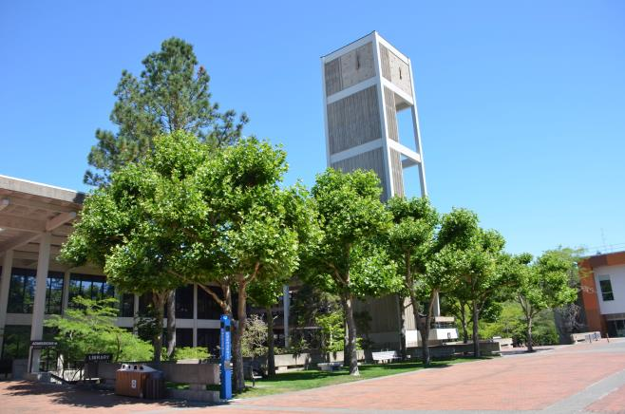
College Prep. Programs & Dual Credit

Slide 14
College Prep. Programs & Dual Credit
2016 Common Language
AP Minimum Credit Awarding: The public baccalaureate sector will grant at a minimum elective credit for College Board Advanced Placement (AP) exams completed with a score of three (3) or higher. May be subject to maximum credit limits. Please contact the institution for additional details.
IB Minimum Credit Awarding: The public baccalaureate sector will grant at a minimum elective credit for International Baccalaureate (IB) higher-level exams completed with a score of five (5) or higher, with exceptions. May be subject to maximum credit limits. Limited credit is granted by Central Washington University and Evergreen for some standard level exams. Please contact the institution for additional details. The public baccalaureate sector recognizes the International Baccalaureate Diploma and awards up to 45-quarter credits (30 semester credits). With the receipt of a Diploma credit will be awarded for 3 courses (15 quarter credits) and distributed evenly among three general education areas (natural sciences, social sciences, arts and humanities). An additional 30-quarter credits (20 semester credits) can be awarded in the areas of the students’ higher level subject exams with a score of 5 or better, subject to maximum credit limits. Please contact the institution for additional details.

Slide 15
College Prep. Programs & Dual Credit
2017 AP Legislation (SB 5234)
SB 5234 (1) The institutions of higher education must establish a coordinated, evidence-based policy for granting as many undergraduate college credits to students who have earned minimum scores of three on AP exams as possible and appropriate.
2018 COP Dual Credit Legislation (SB 6398/HB 2656)
SB 6398 / HB 2656 Concerning concurrent enrollment programs and college preparatory with examination programs
Defined college prep programs and concurrent enrollment programs
Formalizing International Baccalaureate and Cambridge college prep program credit awarding policies in statute,
Set accreditation standards for college in the high school
Created a joint dual credit work group
Created a data workgroup to track dual credit

Slide 16
College Prep. Programs & Dual Credit
2018 IB/Cambridge Legislation (SB 5917)
SB 5917 Requiring a system wide credit policy regarding international baccalaureate and Cambridge international Exams
NEW SECTION. Sec. 2. (1) The institutions of higher education must establish coordinated evidence-based policies for granting as many undergraduate college credits as possible and appropriate for general education requirements or the equivalent to students who have successfully completed international baccalaureate (IB) or Cambridge international courses and demonstrated mastery of college-level curriculum, as shown by the students' examination scores or grades for those programs. The institutions shall take into account the evidence for student success and the relevance of the IB or Cambridge international curriculum and test scores or grades in consideration of granting college credit or waiving course requirements, with appropriate consideration of the institutions' degree distribution requirements or curriculum for specific degree programs. Policies may consider, for example: (a) Whether a four on a standard-level or higher-level IB examination and whether a grade of E on a Cambridge international examination indicates that the student has mastered college-level coursework for which undergraduate college credits may be granted; and (b) What test score or grade for specific subjects indicates if graduation distribution requirements or prerequisite courses may be waived, while preserving the integrity of the institutions' faculty process for determining degree and major curriculum requirements.

Slide 17
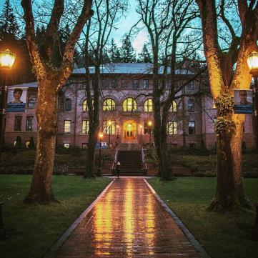
Student Debt & Consumer Protection

Slide 18
Student Debt & Consumer Protection
Student Loan Work Group & Attorney General Legislation
SB 6029 (Liias) Establishing a student loan bill of rights – Creates the Student Education Loan Advocate to receive, review, and provide assistance to student education loan borrowers who file complaints. Requires licensure and regulation of student loan servicers (servicers) by the Department of Financial Institutions (DFI) Requires the Washington State Institute for Public Policy to study student loan authorities that refinance student loans from proceeds of tax-exempt bonds.
HB 1169 (Orwall) Enacting the student opportunity, assistance, and relief act – Provides for the treatment of student loan debts in judicial actions by, repealing provisions allowing suspension of a professional license changing the default judgment interest rate for unpaid private student loan debt, increasing the bank account and wage garnishment exemptions for judgments on private student loan debt, and requiring notification to debtors of their garnishment and lien rights for private student loan debt.

Slide 19
Student Debt & Consumer Protection
Other bills
HB 1439 (Pollet) Regulating the institutions of higher education, including for- profit institutions and private vocational schools, to protect students from unfair business practices – Makes it an unfair practice for such schools to, among other things: (a) provide misleading endorsements; (b) use the US military logo on advertising; and (c) for certain institutions and schools, engage in selling consumer student loan products that financially benefit the institution. Creates regulatory framework that includes DOL and WSAC and requires the creation of a single portal for student complaints
HB 1499 (Pollet) Creating protections and fairness for students in the student loan disbursement process – Requires a postsecondary institution to comply with certain requirements, if the institution disburses a student’s federal or state financial aid balance by means other than directly depositing the student’s balance into the student’s existing account or issuing a check directly from the institution

Slide 20
Other Notable Pieces of Legislation
SB 6582 (Chase) Concerning the criminal history of applicants to institutions of higher education – Prohibits the public institutions of higher education from using initial admissions applications that request information about an applicant’s criminal history.
HB 1561 (Frame) Concerning open educational resources – Requires the Student Achievement Council (Council) to administer the Open Educational Resources (OER) Grant Pilot Program for the public four- year institutions of higher education.
HB 1433 (Stambaugh) Decoupling services and activities fees from tuition – Removes the provision tying the annual increase of service and activity fees to the percentage increase in student tuition fees for the four-year public institutions. Requires that increases to services and activity fees at the four-year public institutions shall not exceed 4% per year.
HB 1293 (Ortiz-Self) Concerning witnessing a student’s college bound scholarship pledge when efforts to obtain a parent’s or guardian’s signature are unsuccessful – Allows a school administrator or counselor to witness a student’s CBS pledge if unable to secure the signature of the student’s parent or guardian.

Slide 21
Operating Budget

Slide 22
Supplemental Operating Budget
Overview of he 2018 supplemental operating budget
Increases NGF-P appropriations for the 2017-19 biennium by a net of $941 million, for total NGF-P for 2017-19 of $44.6 billion.
Net policy spending increases by a net of $1.2 billion.
The largest new investment is $776.4 million for K-12 salary allocations. In addition, $105.2 million is appropriated from the newly created Dedicated McCleary Penalty Account for K-12 public schools; the amount of the accrued McCleary fines is deposited into this account from the state general fund and is appropriated for new basic education expenditures.

Slide 23
Supplemental Operating Budget
Major Higher Education Spending Decisions
State Need Grant: $18.5 million
University of Washington Compensation: $9 million
Washington State Opportunity Scholarship: $4.3 million
Computer Science Enrollments at the University of Washington Seattle: $3 million
Gold Star Family Textbook Stipends: $750,000
New Programs at Western Washington University: $2 million
New and Expanded Community and Technical College Programs: $1.24 million - Federal Way Education Initiative ($500,000), Peninsula College health care workforce development programs ($437,000); feasibility study of establishing a new community college in the Graham area ($300,000).
Compensation and Funding Study –WSIPP will study the proportion of state funding that comes from the state general fund for salary and benefit increases, the manner in which salary and benefit increases are determined, and the total proportion of state funding for institutions of higher education. A report is due by November 1, 2018.

Slide 24
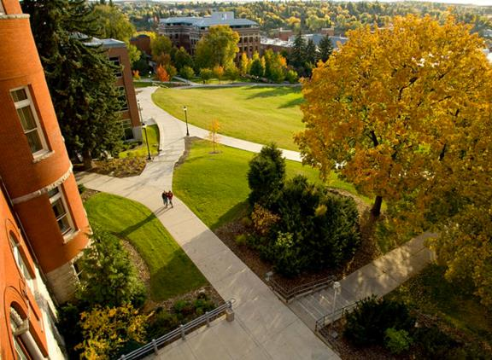
2019 Legislative Session

Slide 26
2019 Legislative Session
Compensation
STEM & High Employer Demand
State Need Grant
Dual Credit
Free College
Career connected learning
Teacher Shortage
Capital Budget

Slide 27
National & International Comparisons

Slide 28
Washington’s Public Baccalaureate Institutions Have the 6th Best 4-year Graduation Rates in the Nation
Source: Education Research & Data Center data downloaded August, 2016

Slide 29
Washington’s Public Baccalaureate Institutions Have the 5th Best 5-year Graduation Rates in the Nation
Percent of students graduating with a bachelor’s degree within 5 years, public institutions in 2011
Source: Education Research & Data Center data downloaded August, 2016

Slide 30
Washington’s Public Baccalaureate Institutions Have the 5th Best 6-year Graduation Rates in the Nation

Slide 31
Washington’s is 3rd in the Nation in Bachelor’s Degrees Produced Per 100 FTE Students at Public Baccalaureates
Source: Education Research & Data Center data downloaded August, 2016

Slide 32
Washington Ranks 48th in Participation in 4-year Public Higher Education at the Undergraduate Level
Public undergraduate 4-year participation rates based on the population age 20-34.
Source: Education Research & Data Center data downloaded August, 2016

Slide 33
Washington Ranks 43rd In Public Bachelor’s Degrees Produced Per 1,000 Population Aged 20 To 34
Source: Education Research & Data Center data downloaded August, 2016

Slide 34
Contact and Resources
Cody Eccles Director of Government Relations & Business Affairs (360) 292-4103 ceccles@cop.wsu.edu
2018 Council of Presidents Legislative Summary http://www.councilofpresidents.org/2018%20Leg%20Report.pdf
Resource page: Legislative trackers, policy documents, legislative presentations http://www.councilofpresidents.org/index-3_issues.html

